Slide 1
Pioneers in Engineering
2013-2014 Competition

Slide 2
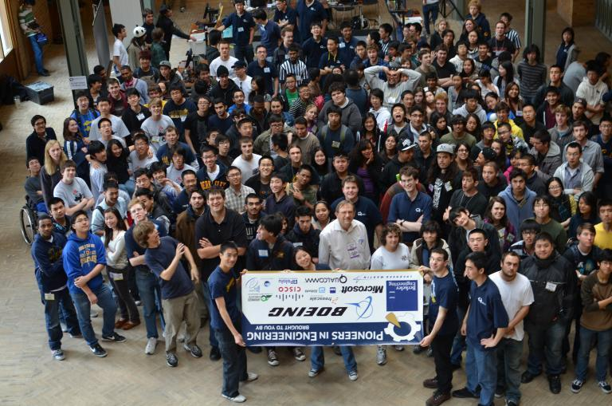
What is PiE?
Pioneers in Engineering
8-week Robotics Competition in Spring

Slide 3
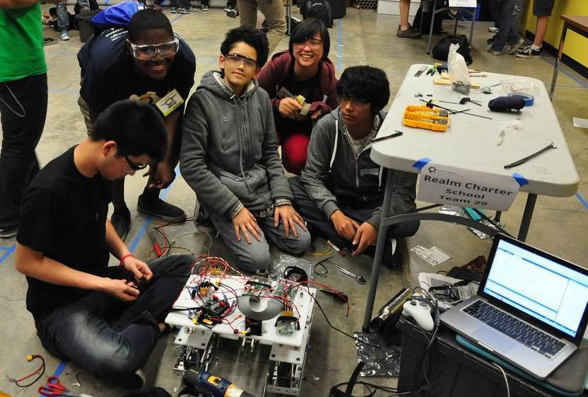
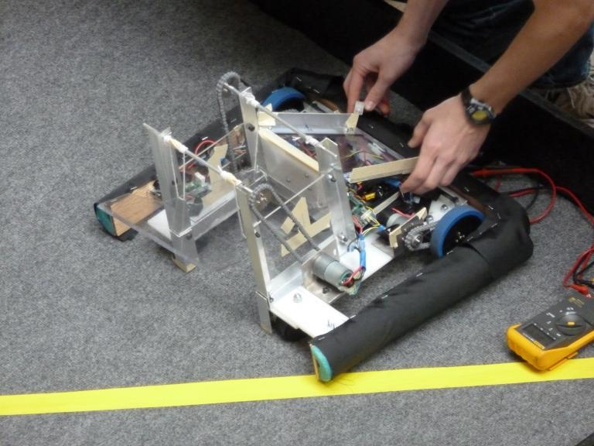
What You’ll Gain
Hands-on engineering experience
Learn to build a robot from scratch!
Everything from designing,
building, programming, wiring, and
testing!
Work as team
All while having fun!

Slide 4
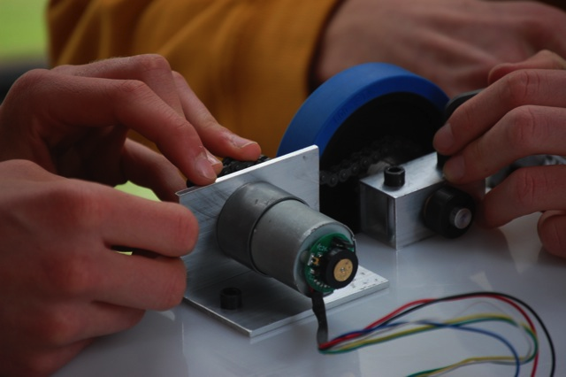
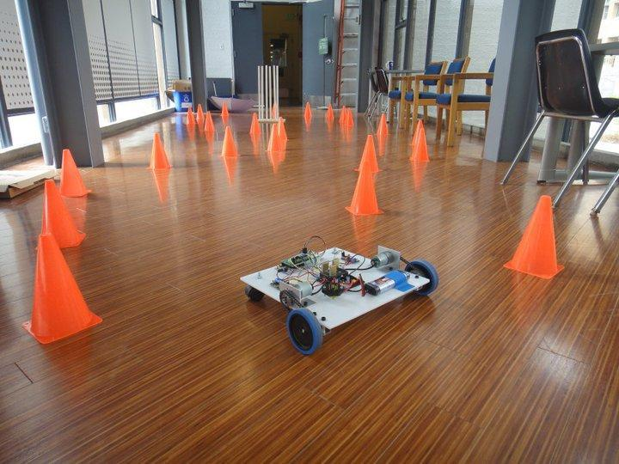
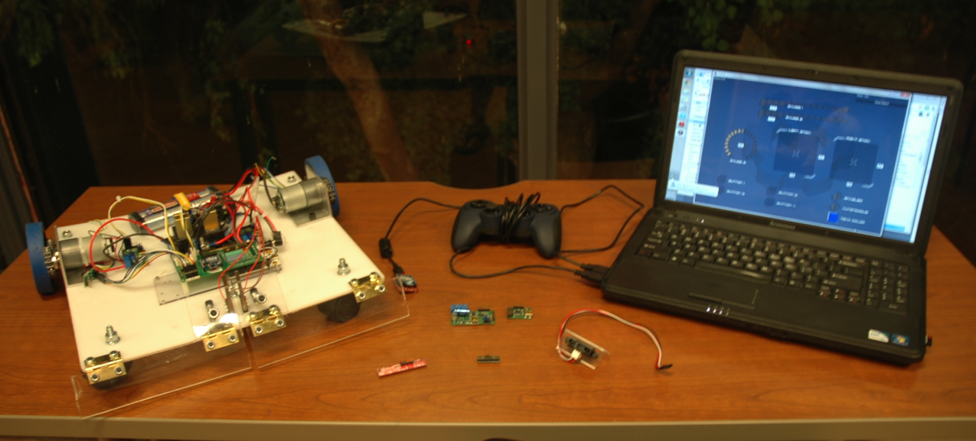
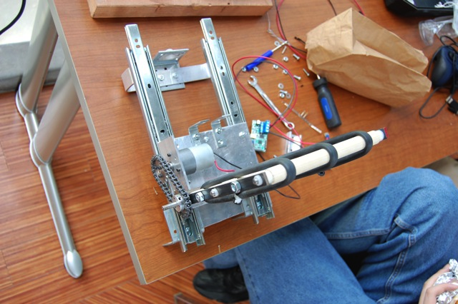
What’s Expected from Teams
Just Your Time!
Meet with mentors
Student work sessions
Attend season events
Build, code, and test!
Have Fun!

Slide 5
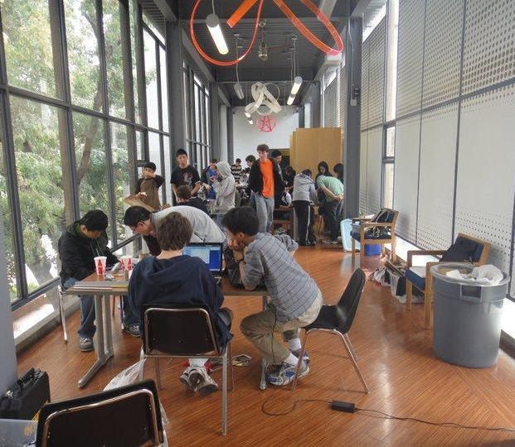
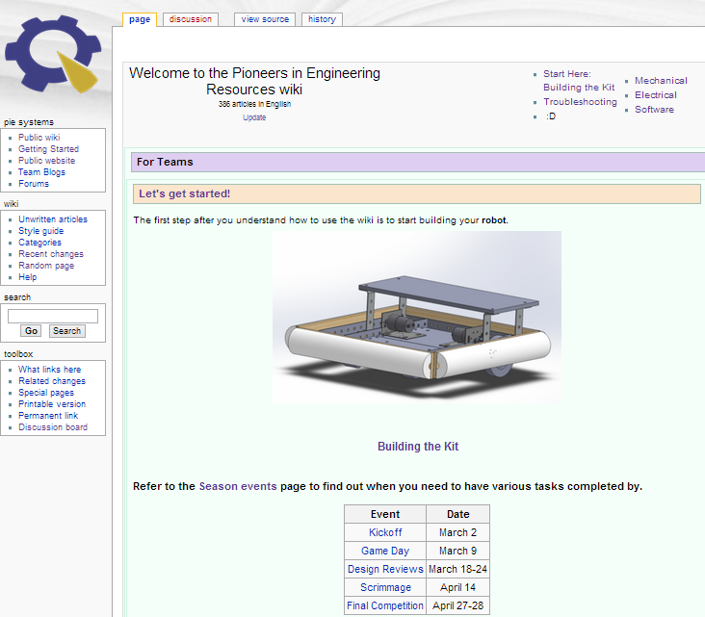
But I’ve never built a robot before!
We’re here to teach!
PiE Mentors & Worksessions
Online Resources
Design Reviews
Prep

Slide 6
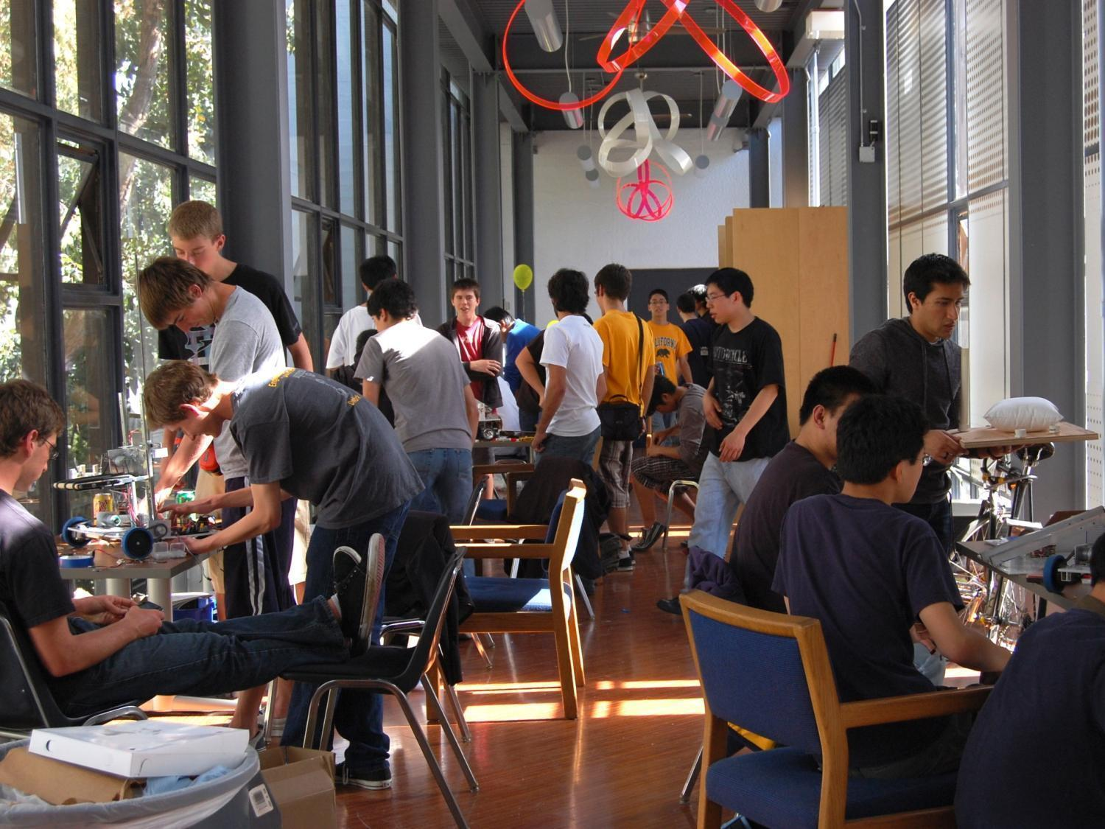
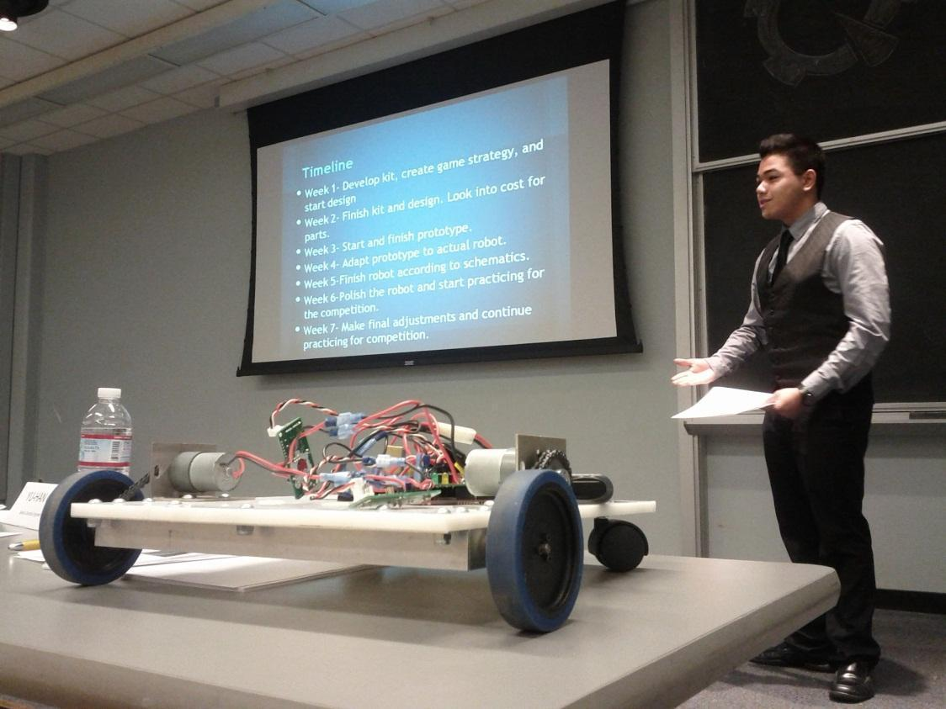
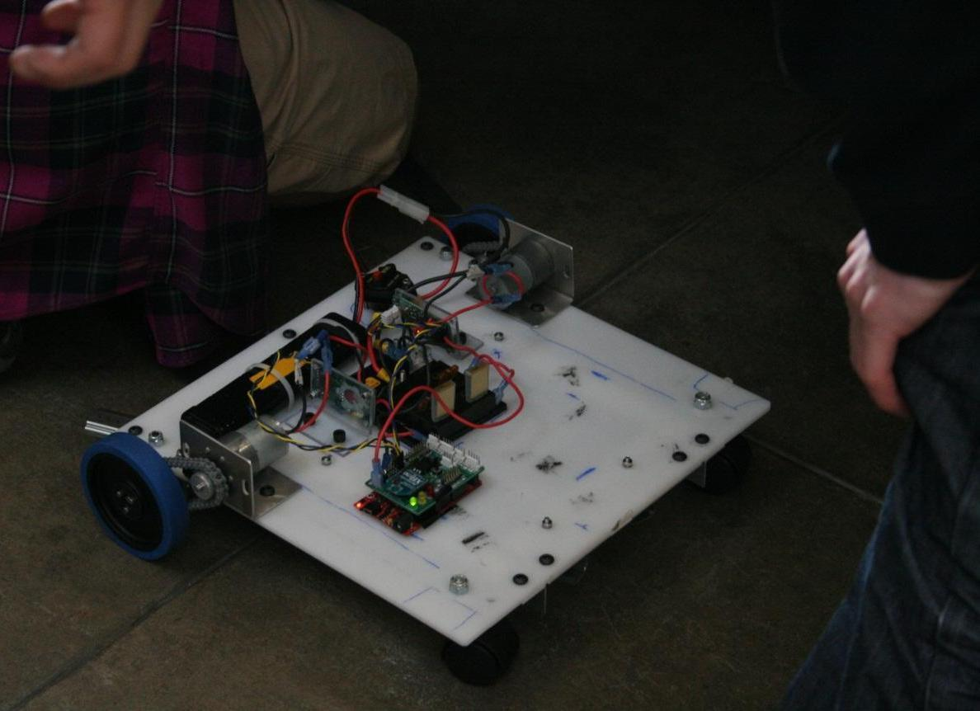
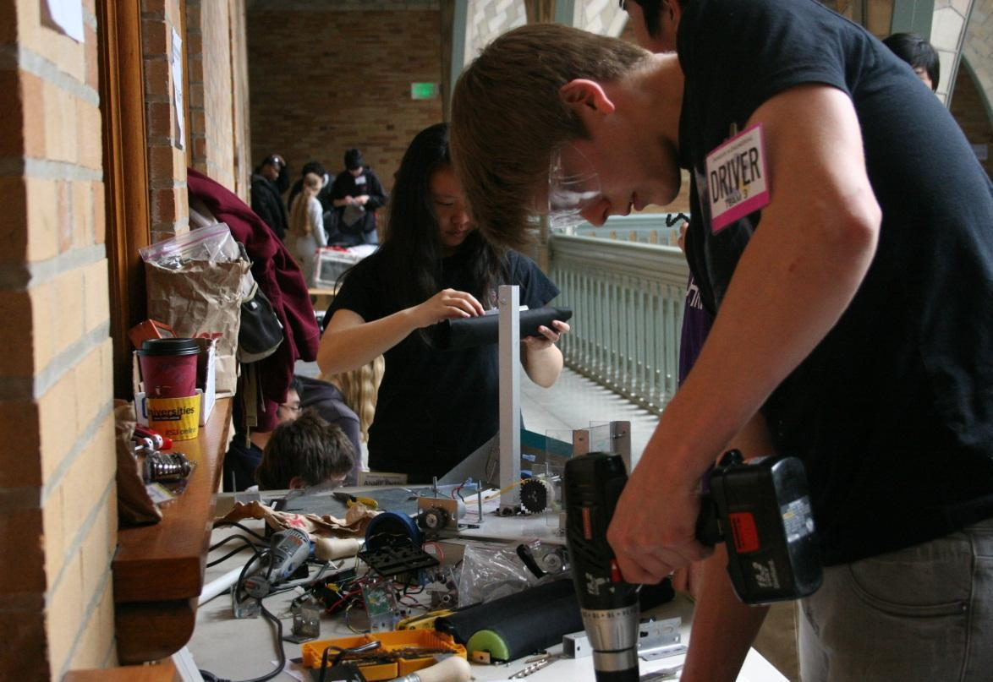

Slide 7
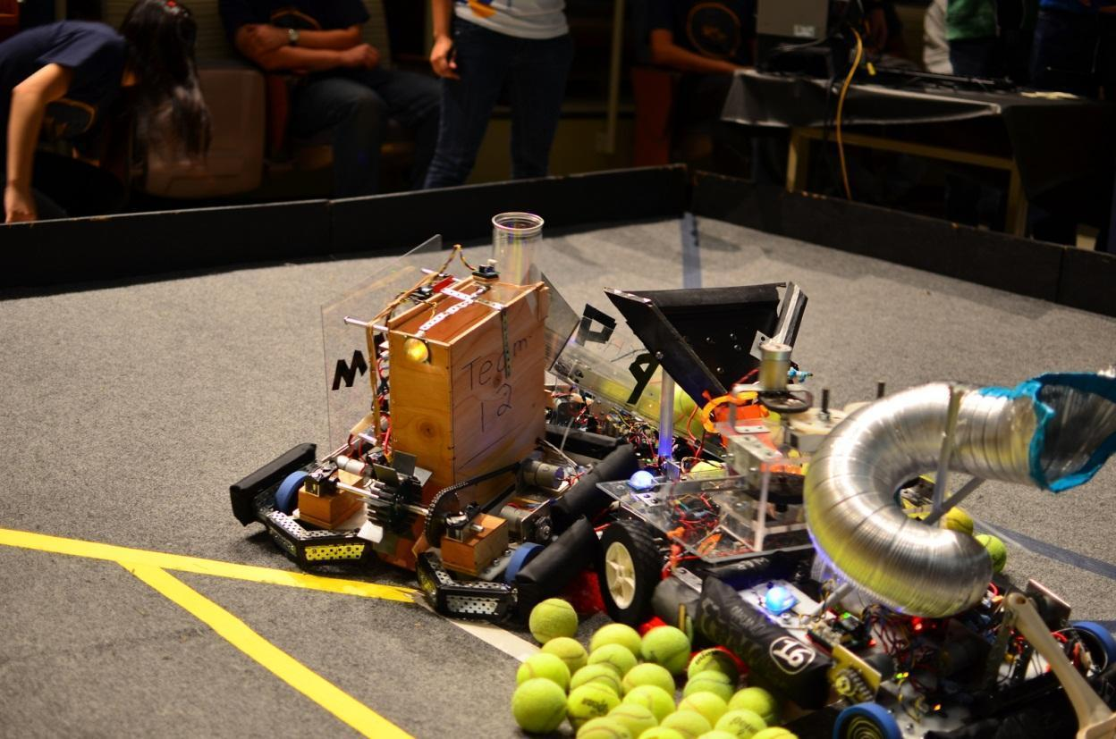
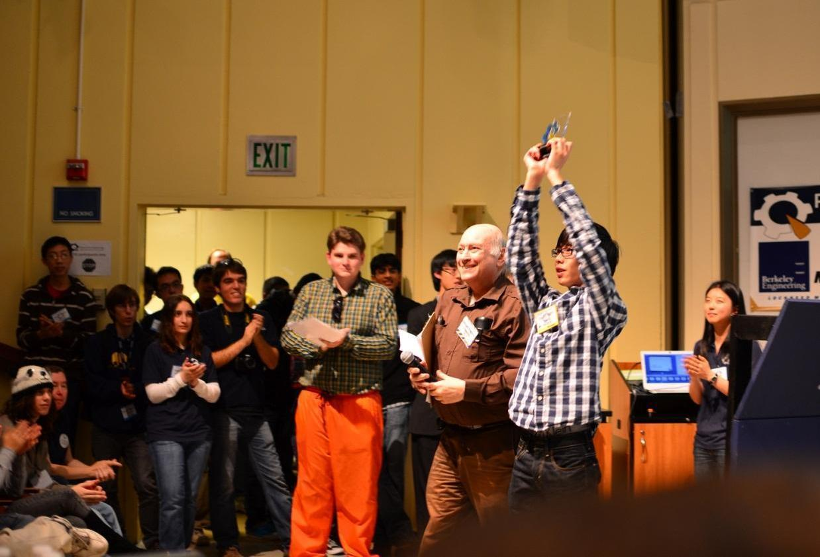
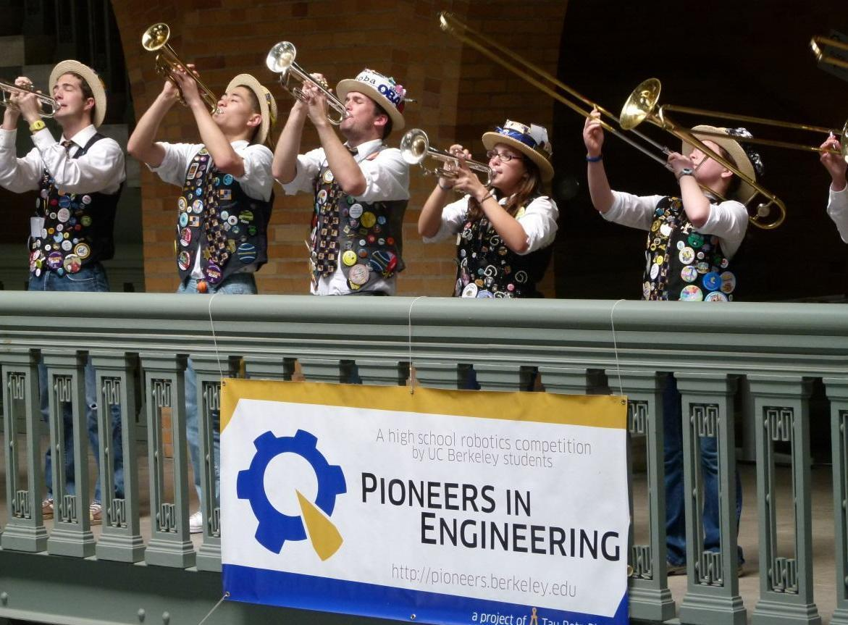
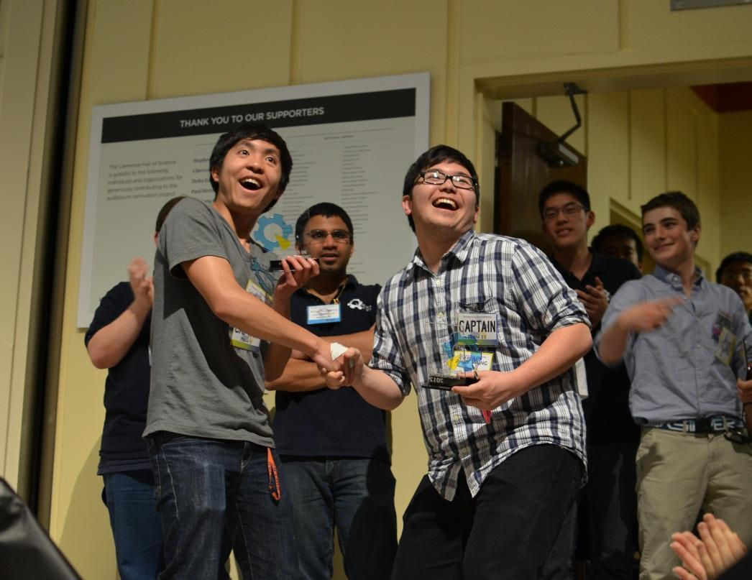

Slide 8
PiE Competition Wrap Up Video

Slide 9


Slide 10
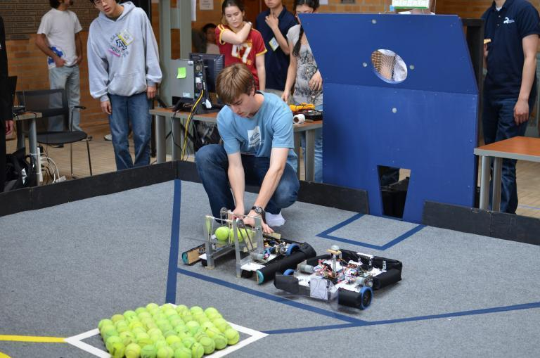
PiE Competition 2011- 2012: Ballistic Blitz

Slide 11
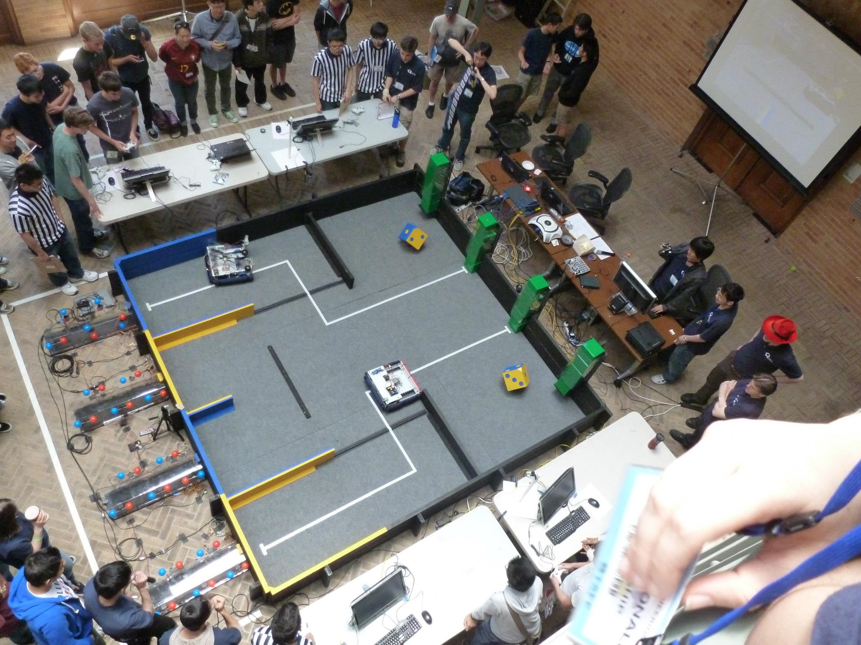
PiE Competition 2012- 2013: Cube Route

Slide 12

What is the game for this year?

Slide 13

We can’t tell you

Slide 14
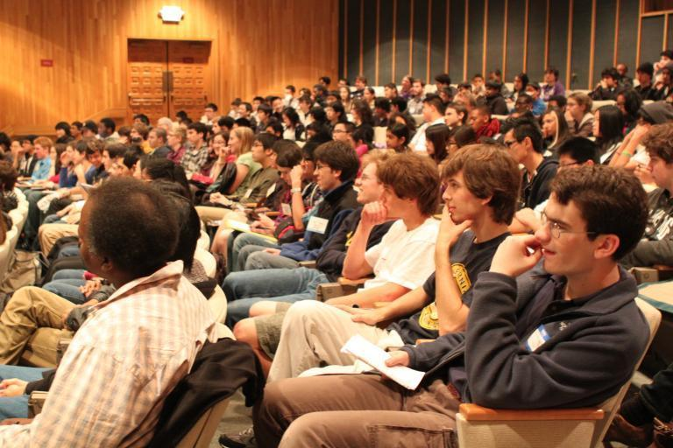
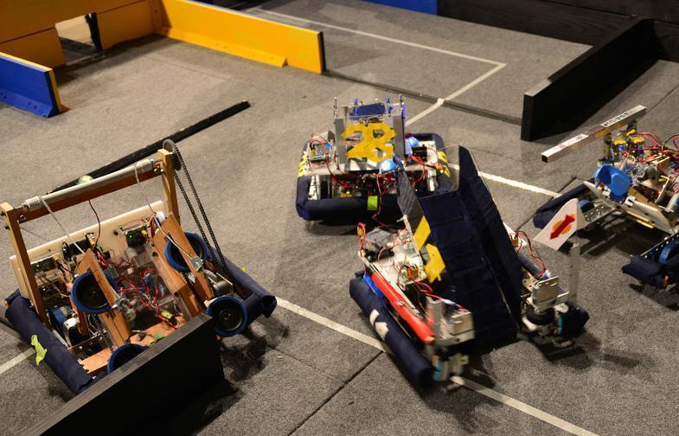
Important Dates
PiE Kickoff– March 1nd, 2014
PiE Game Day– March 8th, 2014
Design Reviews - March 17-21nd, 2014
Scrimmage Competition - April 13th, 2014
Final Competition - April 26-27th, 2014

Slide 15
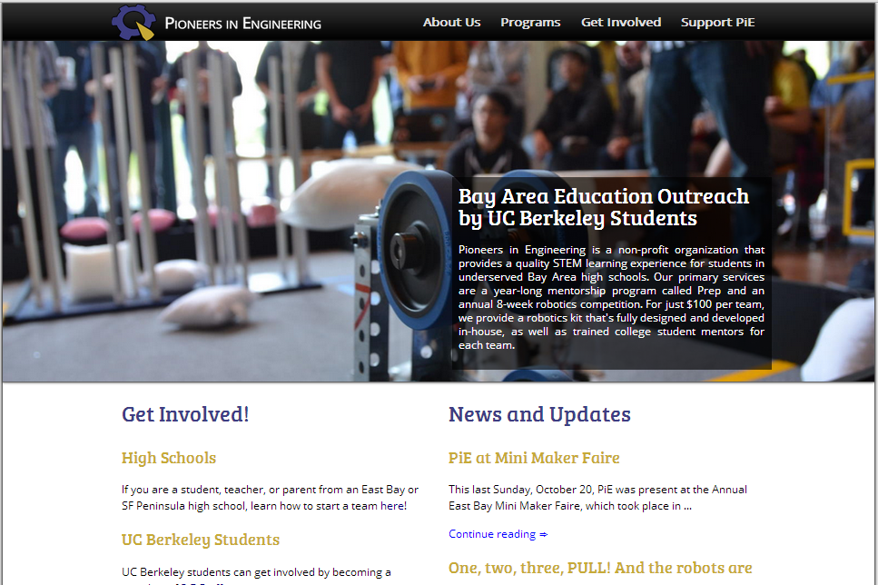
Visit https://pioneers.berkeley.edu/

Slide 16

Thank you

